Slide 1

BIO103 Lab (1 credit hour) SUMMER 2025
Dept. of Biochemistry & Microbiology

Slide 2
Experiment 5
Extraction of plant genomic DNA.

Slide 3
Isolation of plant genomic DNA from spinach
Deoxyribonucleic acid (DNA) is a nucleic acid that contains the genetic instructions for the development and function of living things.
The structure of DNA is called a double helix, which looks like a twisted staircase.
The main role of DNA in the cell is the long-term storage of information
There are four different bases:
adenine (A), cytosine (C), guanine (G), or thymine (T).
The two strands are held together by hydrogen bonds between the bases, with adenine
forming a base pair with thymine, and cytosine forming a base pair with guanine.

Slide 4
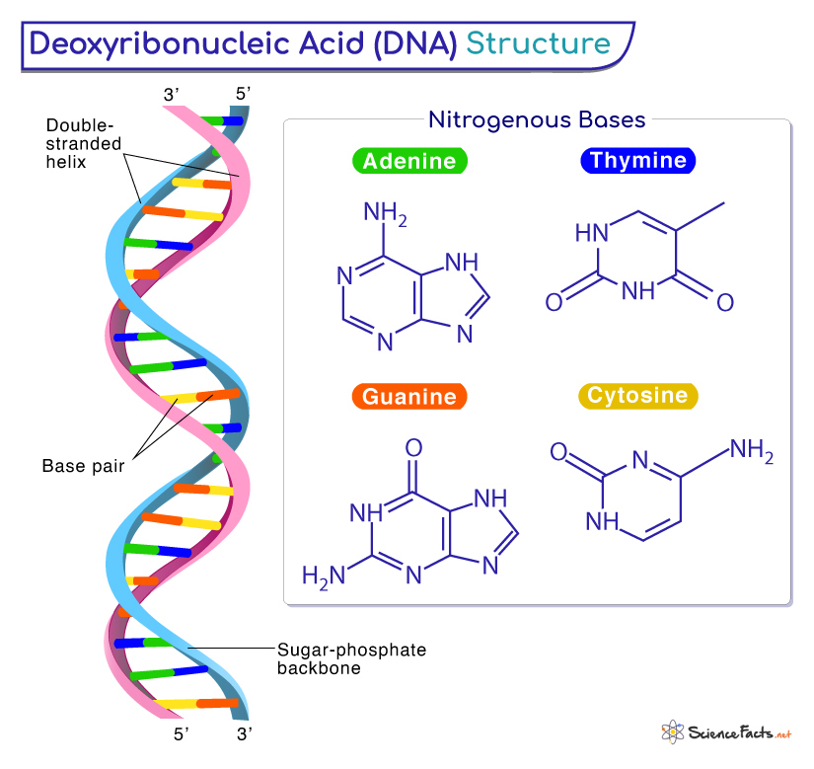
Structure of DNA

Slide 5
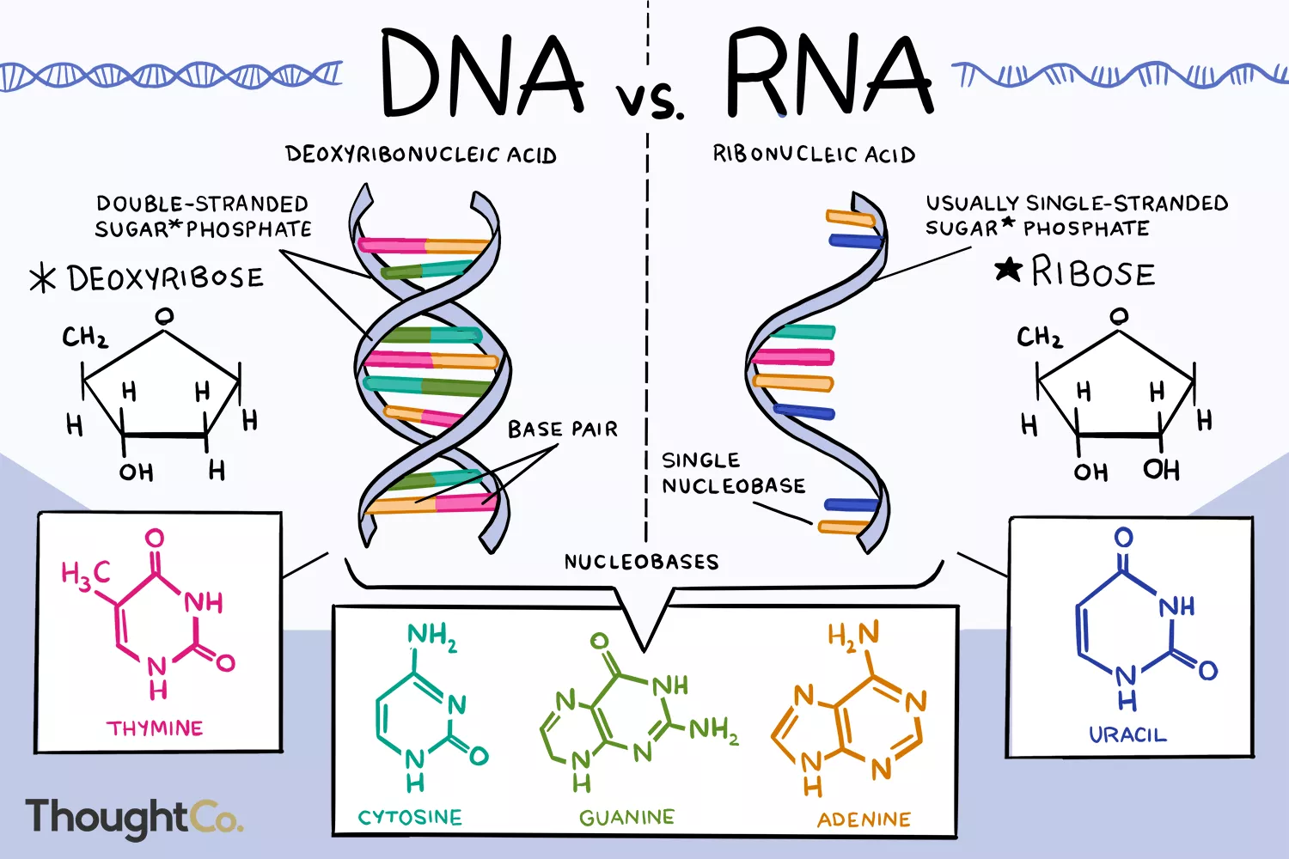

Slide 6
Functions of DNA
DNA has many important functions in living systems, such as-
DNA contains the instructions needed for an organism to develop, survive and reproduce.
It stores instructions for making other large molecules, called proteins.
It is the genetic material passed from parent to offspring.
Diagnosis of Genetic disorder.
Forensic Test for criminal investigation, paternity testing.
Gene therapy works by replacing or inactivating disease-causing genes
Notes:
Phosphate group: A major requirement of all living things is a suitable source of phosphorus. One of the major uses for phosphorus is as the phosphate ion which is incorporated into DNA and RNA.

Slide 7
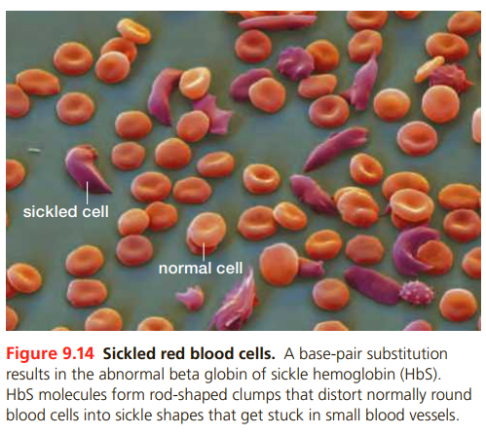


Slide 8
DNA Extraction
DNA can be isolated from living tissues e.g., spinach, banana, onion.
DNA isolated from the nucleus, for which cell wall and plasma membrane must be broken down by mechanical forces, in the presence of salt and detergent.
Isolation of DNA from plant material poses special challenges, i.e., several plant metabolites have chemical properties similar to DNA.
Young and healthy tissues are recommended to use for DNA extraction
Young tissues contains more cells than older tissue.
Young tissue of the same weight contains fewer metabolites.

Slide 9
Principle
The process of isolating nucleic acid is a crude extraction method.
By using salt and detergent solution causes the cell membrane to break down or lyse and emulsifies the lipids and proteins of the cell.
After incubation period, the crude mixture is filtered to get homogenized solution.
Pouring of this solution into petri dish and glass tube containing 95% ethyl alcohol or ethanol, causes the precipitation of DNA in time.
After some moment, it appears as thick, stringy, white or slight greening mass.
As DNA is not soluble in alcohol, can be isolated as they clamp together and become visible to the naked eye.

Slide 10
Experiment
Materials
Procedure
Measuring cylinder, beakers
Mortal and pestle
Light colored dish washing liquid
Ethanol 95%
Large spoon for mixing
Petri dishes
Strainer/ funnel
Salt
Filter cloth or paper
Chop and grind sample
Add liquid with solution detergent and salt
Incubate at 56°C for 10 minutes
Filtration
Add 95% ethanol and visualize DNA

Slide 11
Thank you!

